Slide 1
Project 4 – Car pricing predictor
Colin Roberts
Mitchell hatchett
Jaylen whittaker
Connery hinson
Paul anderson

Slide 2
Project summary
The “Car Price Analysis and Prediction” project involves delving into a dataset encompassing various attributes of used cars, ranging from price and make to fuel type (electric, hybrid, gasoline), color, and horsepower. Through data analysis, we aim to uncover the key factors influencing car prices. Moreover, predictive modeling will enable us to estimate the price of cars based on their attributes, empowering private sellers and dealers to make informed pricing decisions. The data could then be used by an automobile seller as a guide on how to target their customer base and maximize sales.

Slide 3
Process
Find and clean the data, using pandas, create a few visualizations to ensure the data is clean and usable. Create csv files for export and use in the next step
Use a PostGreSQL database to create and join tables, the goal being to have all the pertinent data contained in one or two tables. Perform basic queries to ensure data integrity
Create visualizations in Tableau
Create machine learning model, probably in Colab Jupyter Notebook to handle the predictive analysis that is the ultimate goal of this study.
The interactive piece would allow a seller to input information about their car, and get an estimate of what it would sell for on the market.

Slide 4
Data cleanup
We used several csv files from various sources.
Used pandas to clean up the files, dropping some irrelevant columns, adding an index in some cases.
Code for the cleanup found in the repository

Slide 5
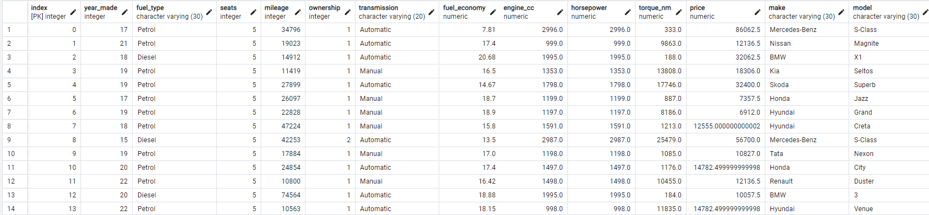
SQL DAtabase
After the data were cleaned, we created a SQL database for easy queries and to check the quality of the data. Three tables were eventually used. This one took into account items like horsepower and number of owners

Slide 6
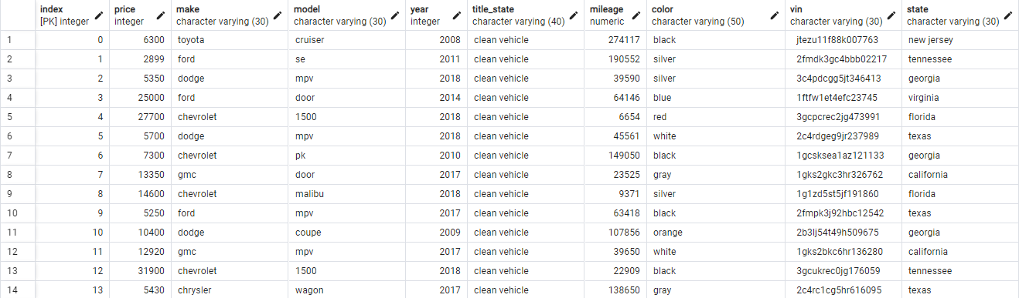
Second table
This table added additional parameters like color and state

Slide 7
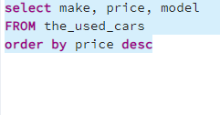
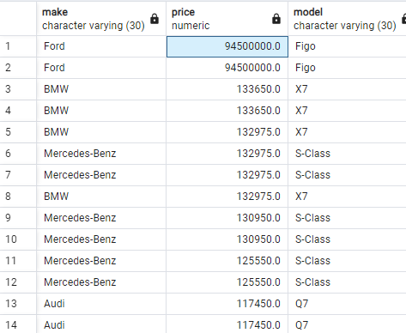
The SQL database made it easy to spot outliers and possible mistakes in the data, and we used the clean tables for our machine learning model, visualizations and the interactive parts of our projects as well.
What is a Ford Figo and why does it cost $94.5 million? Obviously an error in the dataset.

Slide 8
Used car Price predictor using Flask
Several columns are converted to numeric types to ensure proper analysis. The price column is converted from "lakhs" to USD using a conversion rate of 1 lakh = 1350 USD. The original price column is then dropped. Unnecessary columns, such as 'Unnamed: 0', are dropped. The 'ownership' column is renamed from a misspelled version to ensure consistency in the dataset. cleaning and preparing the dataset for further analysis, ensuring that all relevant data is in the correct format for subsequent modeling and evaluation. The we identify missing values in both datasets and drops rows with missing data to clean the datasets further. datasets are merged based on common columns such as index, Make, and Model. We used various machine learning tools such as LinearRegression and RandomForestRegressor to plot future prices in next five years.

Slide 9
Used car price predictor using flask
Using Pandas Numpy and SKLearn libraries All the factors are normalized using Min-Max scaling to a scale of 0 to 1. This step ensures that each factor contributes proportionally to the final score, making the different criteria comparable by 3. Then sum up the normalized values of the positive factors. Those being Fuel efficiency, torque, horse power and year made. Subtracting the normalized values of the negative factors. Engine size, mileage, price and previous owners. The resulting score is then normalized to a 0-100 scale to make it easier to interpret.

Slide 10
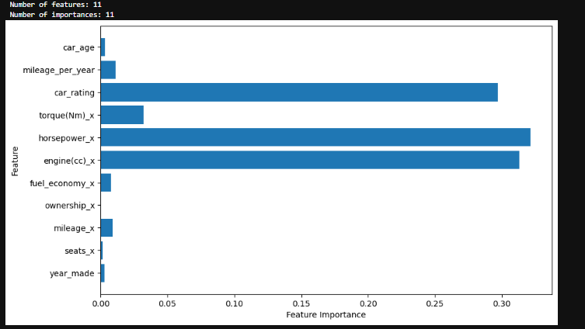
Used car price predictor using flask
Then identified the rows that were most important for the price prediction model. These columns being the car rating, horsepower and engine.

Slide 11
Py app with flask for the used car estimator
Using flask and python upon initialization, the app loads two key datasets. web application is designed to estimate the value of used cars and provide a detailed rating based on various criteria These dropdowns are dynamically populated based on the unique options extracted from the datasets, ensuring that users only see relevant and available choices. Upon form submission, the app attempts to find an exact match in the dataset to calculate an average price based on similar listings. If no exact match is found, it broadens the search or defaults to an overall average price of the make and models average . The app also retrieves a rating for the selected car make and model, displaying it alongside the estimated price. The application is designed with basic error handling and is deployed on Heroku through github.

Slide 12
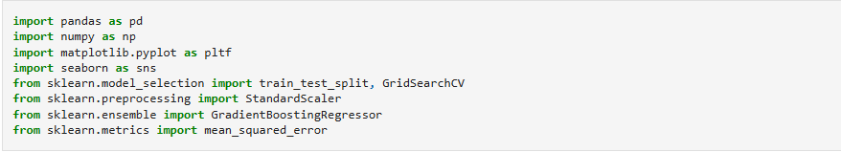
The machine learning model

Slide 13
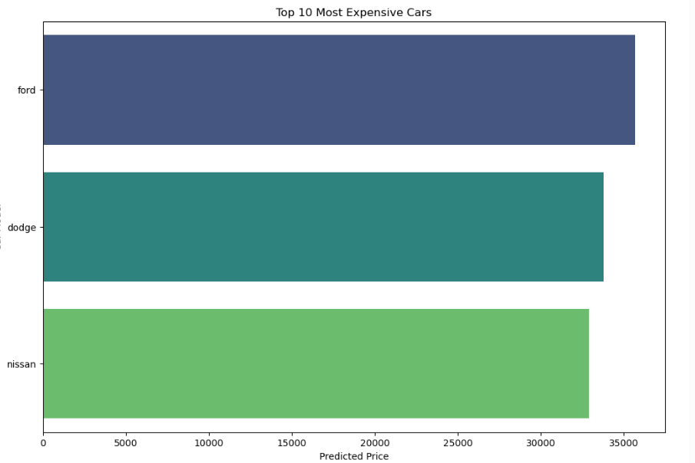
We used our cleaned data in python/pandas to construct a model to predict the price of used cars, and compared our predictions to the data

Slide 14
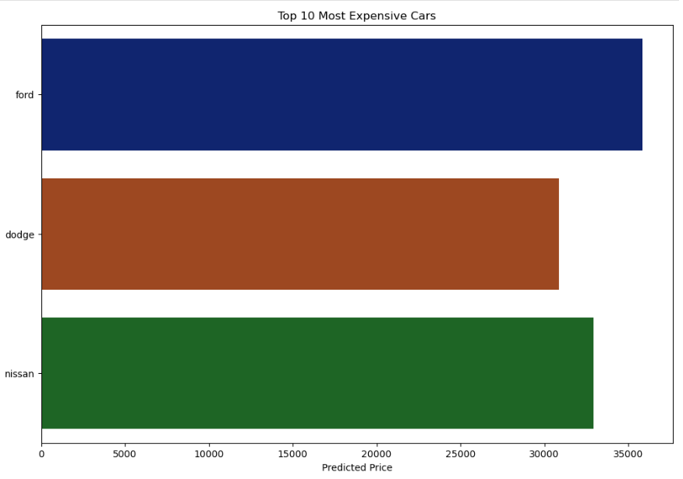
Refining the model

Slide 15
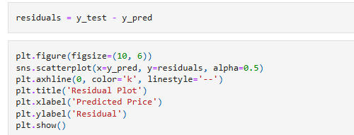
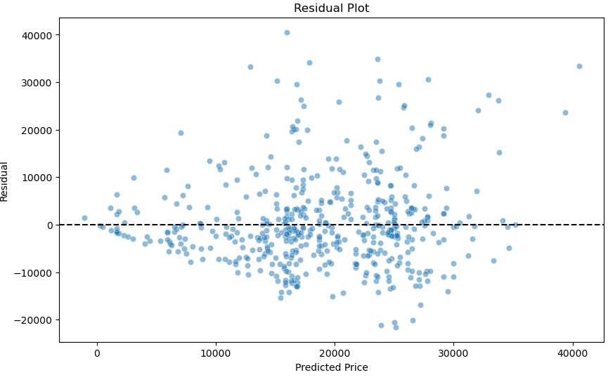
A residual plot of the model

Slide 16
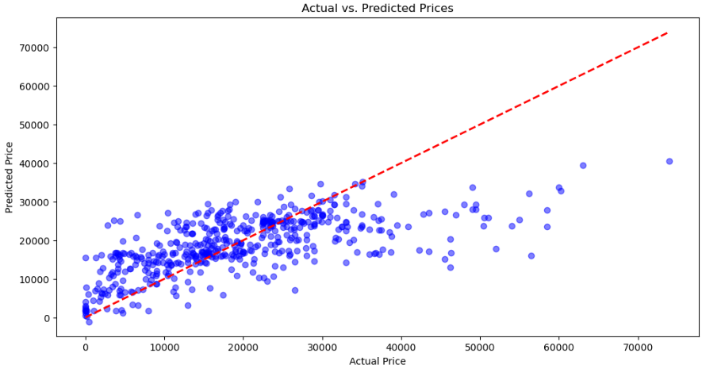
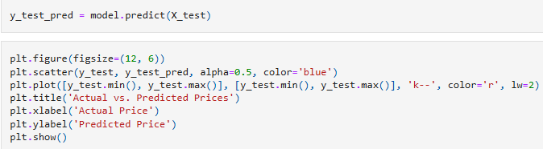
A plot of actual vs. predicted prices

Slide 17
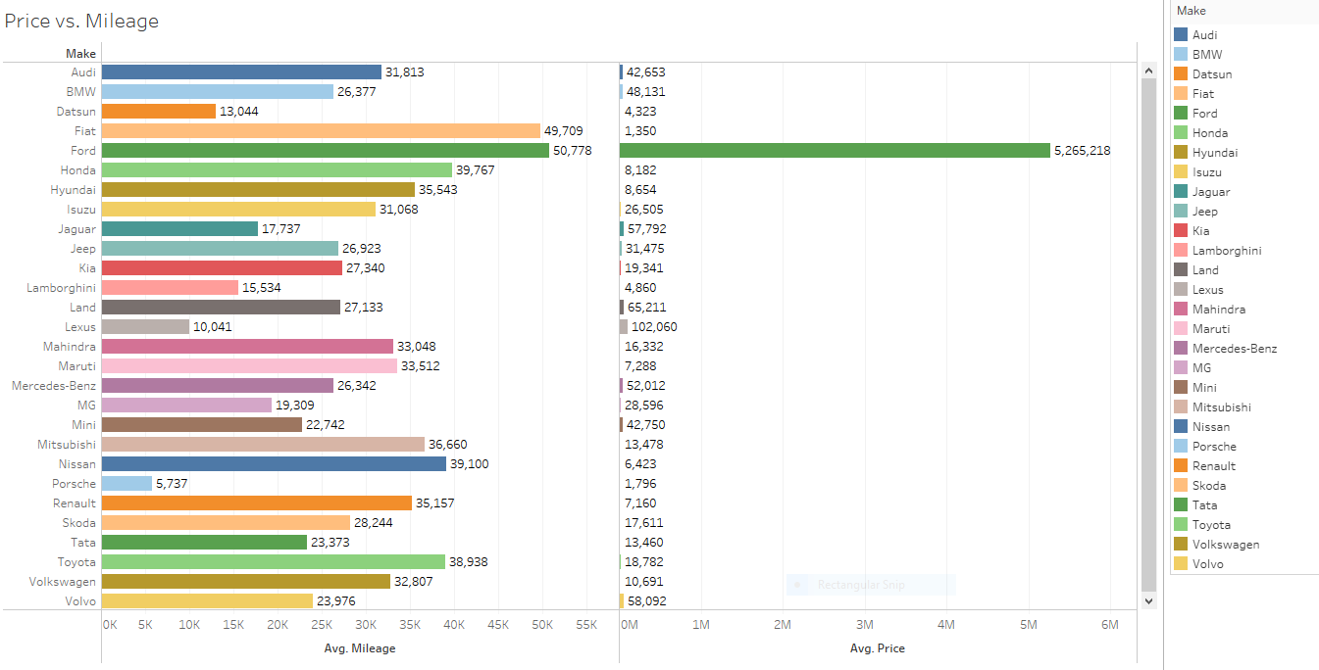
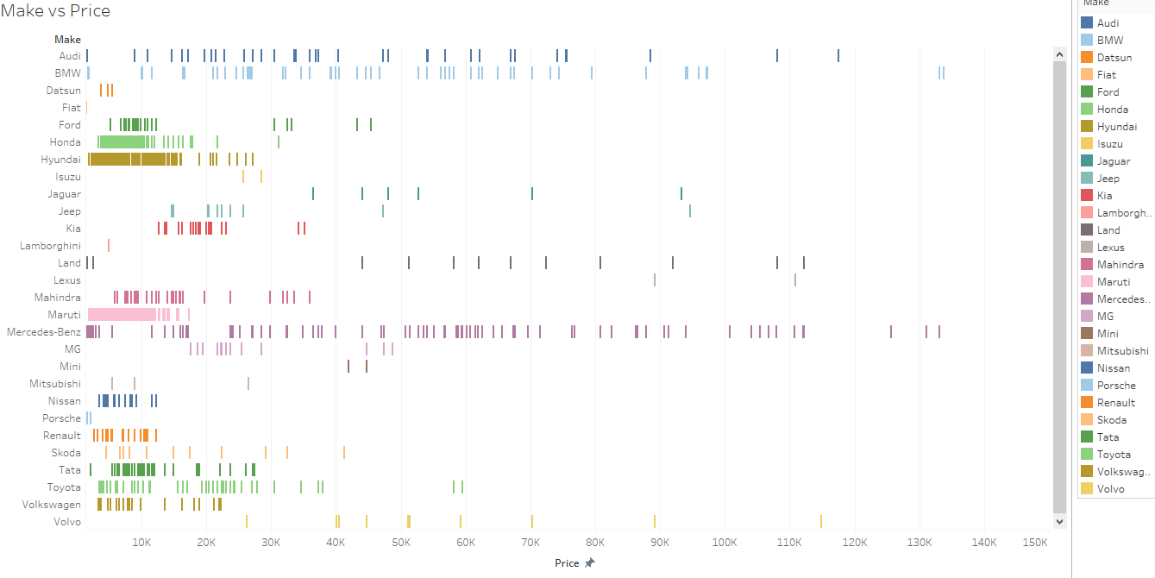
Next, we used the data to create visuals in Tableau. Here are some examples. The rest can be found at the link to tableau public in the repository

Slide 18
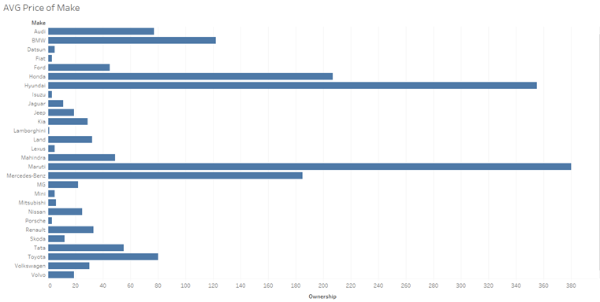
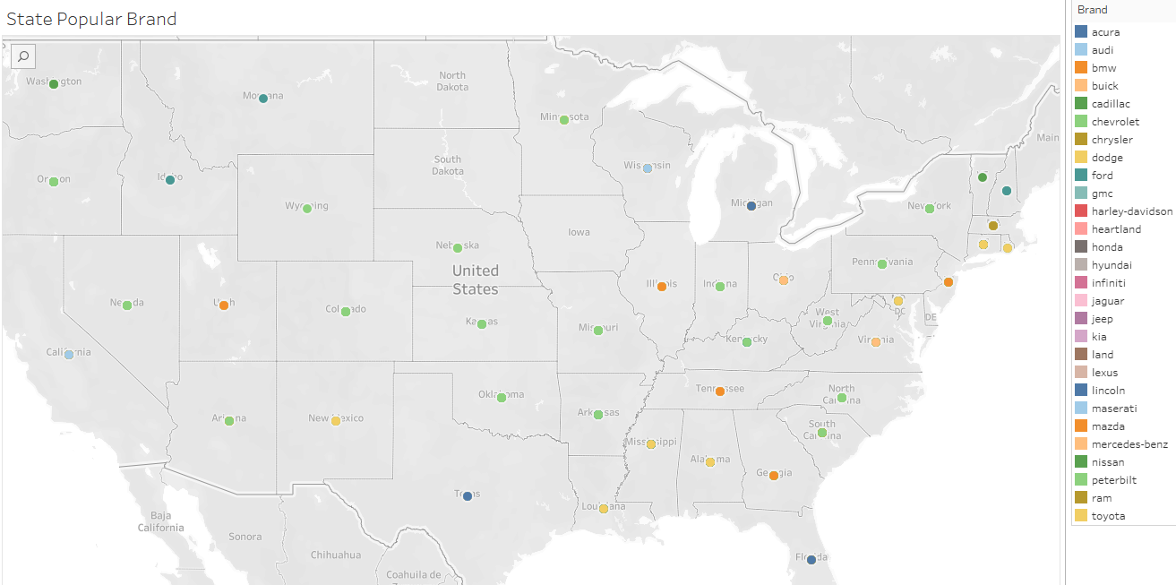
Visualizations

Slide 19
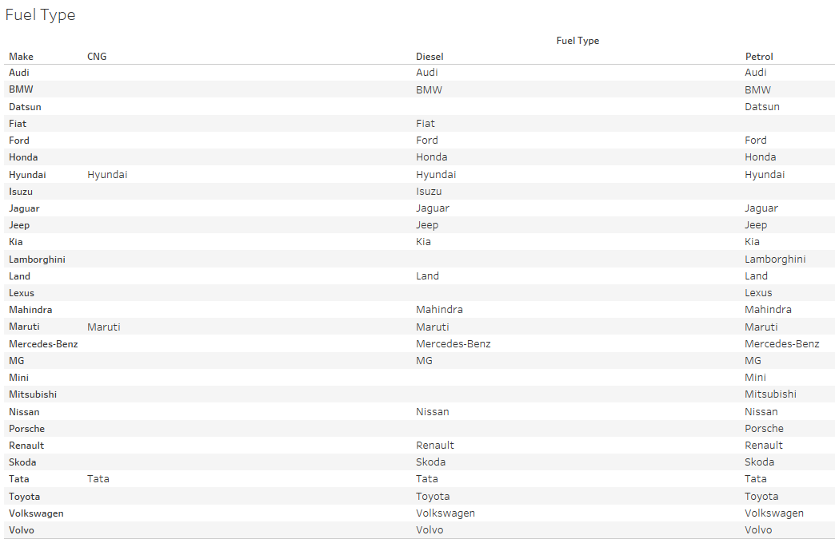
Visualizations

Slide 20
results and features
Using a combination of datasets and APIs from sources on the internet, we were able to construct a machine learning model that accurately predicted the price of a used car based on various criteria, such as price, make, model, and year.
We were able to construct visualizations to illustrate the model
We were also able to incorporate an interactive link, where users could estimate the value of a car they were trying to sell, based again, on similar criteria that they input

Slide 21
Questions

